Slide 1
Evaluating QANet on SQUAD 2.0
Parthasarathy Suryanarayanan
Yash Mangilal Jain

Slide 2
Agenda
Problem
Machine reading comprehension and question answering
Answerability challenges
SQUAD dataset
Approach
QANet
Results
Analysis
Conclusions
References
Notes:
Hello, This is Parthasarathy Suryanarayanan and Yash Mangilal Jain
Today we will talk about our default final project for the course CS 224n called “Evaluating QANet on SQuAD [2.0]”
We begin by taking a look at the machine reading comprehension problem and its relation to question answering. Then we discuss the challenges introduced by answerability and the SQUAD [2.0] dataset which contains unanswerable questions. We will then dive into the QANet architecture and our implementation of it. We then discuss the results our analysis.

Slide 3
Machine reading comprehension and question answering
Central task in natural language understanding
Formulation: “A machine comprehends a passage of text if, for any question regarding that text that can be answered correctly by a majority of native speakers, that machine can provide a string which those speakers would agree both answers that question, and does not contain information irrelevant to that question” - Burges et al
Question-answering:
Given
C = {c₁, c₂..., c_{n}}
Q = {q₁, q₂..., q_{m}}
Output a span S = {c_{i},_{ci+1},...c_{i+j}}
Answerability
Notes:
A major goal of NLP is to develop agents that can understand natural language. Such an ability can be tested with a reading comprehension task that requires the machine to read open-domain documents and answer questions about them.
Burges et al, formulate machine comprehension in terms of Question Answering as shown above.
More formally given a context of n words and a question of m words, we want to output a span from the context.
Typical reading comprehension systems can often locate the correct answer to a question in a context, but they also tend to make unreliable guesses on questions for which the correct answer is not in the context.
In order demonstrate true reading comprehension, an intelligent system abstain from answering such questions.

Slide 4
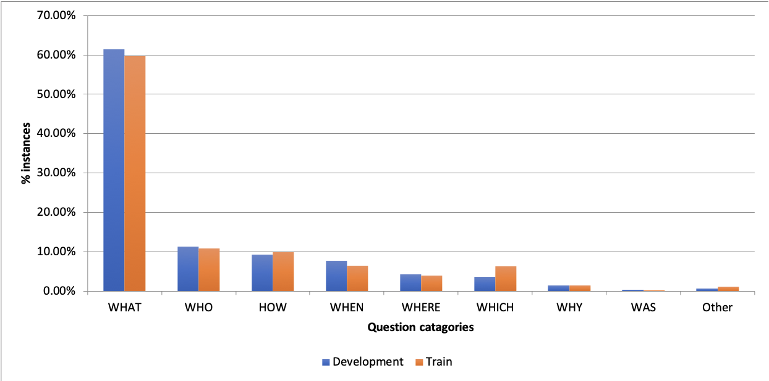
SQuAD [2.0]
Crowd-sourced, 442 Wikipedia articles
Wh-type questions
Train, dev, test : 12941, 5951, 5918 questions
~50% unanswerable
Dev: 2848 unique answers (47.8%), 194 (7.4%) duplicates
Challenging dataset: Systems that achieved 86% F1 on SQuAD 1.1 scored only 66% F1 on SQuAD 2.0. (2018)
Near-human performance by PCE-based neural architectures (March 2019)
Pranav Rajpurkar, Robin Jia, and Percy Liang. Know what you don’t know: Unanswerable questions for squad. arXiv preprint arXiv:1806.03822, 2018.
Notes:
Prior to SQuAD [2.0], majority of the datasets, including earlier version of SQuAD, focused exclusively on answerable questions.
2.0 contains crowed sourced questions on a set of Wikipedia articles, where approximately 50% of questions are unanswerable.
Slide shows some statistics about the dataset.
Initially when the dataset was released in 2018, systems that performed extremely well on 1.1 performed relatively poorly on 2.0.
But as of March 2019, neural architectures based on pre-trained contextual embedding (PCE), have reached near human performance as well.

Slide 5
Approach / QANet
A leading non-PCE method
SQuAD [1.1] performance: EM: 82.47 and F1: 89.30
Not systematically evaluated on SQuAD [2.0] to our knowledge.
Before QANet, typical architecture:
recurrent units
attention mechanism
Key idea: non-recurrent encoder + self attention
Claim to fame: speed.
Approach:
Implement QANet from the ground up
Evaluate with SQuAD [2.0]
Study and document the observations
AdamsWeiYu,DavidDohan,Minh-ThangLuong,RuiZhao,KaiChen,MohammadNorouzi,andQuocV Le. Qanet: Combining local convolution with global self-attention for reading comprehension. arXiv preprint arXiv:1804.09541, 2018.
Notes:
Even though non-PCE methods are no longer the state of the art anymore, we have chosen to implement one of the leading non-PCE modes called QANet. Our motivation behind choosing this was to carefully study the key ideas (such as, attention mechanism, pointer networks etc.) from the recent innovations of neural architectures that the QANet is built upon. We hoped to gain hands-on experience by implementing the architecture “from the scratch”.
QANet achieved an impressive performance against SQuAD [1.1] dataset.
Prior to QANet, major question answering systems primarily contained either of two key ingredients (1) recurrent units such as LSTM for capturing sequential input and (2) exploiting attention mechanism for capturing long- term interactions.
However, due to the sequential nature, (1) can’t be parallelized to exploit the hardware and is slow. To achieve the speedup, the QANet borrows a neat idea from NMT, proposed in the Transformer: encode the question and context separately using a non-recurrent, therefore faster, encoder. This encoder uses convolution (which models the local features) and self-attention (which models global interaction) as building blocks.
The parallel nature of CNN architectures leads to a significant speed boost, especially given the fact that context passages in SQuAD are really long. It is 13 times faster than previous systems during training and up to 9 time faster during inference.
The first of our two step approach is essentially implementing the architecture carefully as specified in the paper. The second step is to perform an error analysis on the development set, understand the strengths and weaknesses of the model come up with a few ideas that might help the performance. We describe the QANet architecture in the following section at a high level.

Slide 6
QANet
Notes:
Here we show the QANet Architecture. It is a deep model with several layers. It borrows several key ideas from the transformer architecture.
A key component of this architecture is called “encoder block”, which has four layers.
1. Positional embedding layer: Encodes the position of a word within a sentence which carries useful information for the model. In an RNN, this information is trivially encoded as the inputs are presented to the model one step at time. But for non-RNN model, a “positional encoding” is needed to be given explicitly. This layer adds the positional encoding to the input at the beginning of each encoder layer similar to the Transformer architecture.
2. Convolution layer: This is repeated multiple times and the number varies based on the location of usage of the encounter block. the implementation uses depth-wise separable convolutions which require an order of magnitude less computation to achieve nearly the same result as the normal convolution. This is a key ingredient of the speedup. (Details: kernel / filter size: 7, number of filters: 128)
3. Self-attention layer: the multi-head attention mechanism, again from Transformer is used with number of attention heads as 8. Attention key depth is 128 and depth per head is 16.
4. Feed-Forward layer
Having seen the encoder block, let us look at the rest of the architecture.
Embedding look up is performed on the question and the context. The embedding layer combines the word and character embeddings into a singular representation for each word
After that, the context and the question are passed through an encoder layer. This layer uses a single encoder block with 4 convolutions.
Thereafter the output from the encoders are fed to the Context-Query attention layer which combines context and query and produces a representation for each word in context.
The model encoder layer consists of 3 stacked encoder blocks that share weights.
The key layer for prediction is the output layer. The model outputs probabilities for all pairs similar to other pointer networks for reading comprehension Ultimately these probabilities are turned into a span consisting of a start index and an end index, indicating the location of the answer in the context paragraphs.

Slide 7
Experiments
Hyper parameters specified in the paper except
The hidden_size of the model was set to 96 instead of 128 due to hardware limitations.
Hyper-parameter search was limited to changes in number of heads for the multi-headed attention.
Baseline – BiDAF – ran for 30 epochs with batchsize 64
2 Experiments of QANet with batch size 32 – 16 minutes / epoch
1 attention head – 53 minutes / epoch
4 attention heads – 80 minutes / epoch
System Configuration
NV6 class of GPU machines provided by Microsoft Azure with 8GB of video memory.
~7.9GB was used during training
Regularization
L2 weight decay on all trainable kernels with λ = 3e−7.
Dropout with drop_prob = 0.1 after every other layer. Additionally dropout is applied word embedding and character embedding with drop_prob of 0.1 and 0.05 respectively.
Stochastic depth dropout(layerdropout) on every sublayer in an encoder block.
Notes:
Here, we describe the experiments conducted by us to evaluate the performance of the QANet model on the SQuAD [2.0] dataset. All the experiments were run with the hyper parameters specified in the paper except for the hidden_size which was set to 96 instead of 128.
Our hyper-parameter search was limited to changes in number of heads for the multi-headed attention.
We ran two experiments with 1 and 4 attention heads respectively.
The hardware used for the experiment is NV6 class of GPU machines provided by Microsoft Azure with 8GB of video memory. It was observed that close 7.9GB was used.
The baseline BiDAF model was run for 30 epochs. The two QANet experiments were manually stopped before 30 epochs upon observing the stabilization of dev NLL.
The BiDAF was run with batch size of 64, the QANet was run with batch size of 32 due to memory constraints.
We use three different regularization techniques as specified in the paper.
It is to be noted that as a departure from the QANet paper, we chose not to implement any data-augmentation due to time-constraints.

Slide 8
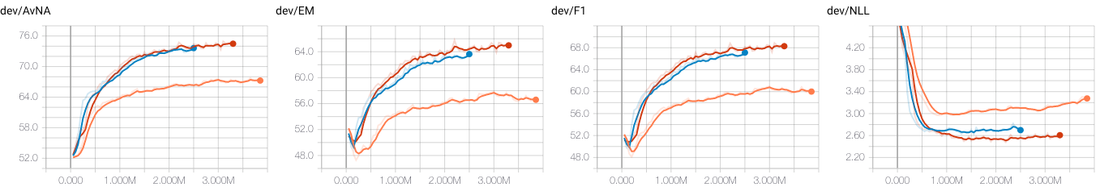
Results
Non-PCE test leaderboard – 60.57 EM and 64.44 F1
Non-PCE dev leaderboard – 65.68 EM and 68.67 F1
Notes:
Our model achieves competitive scores of 60.57/64.44 of EM and F1 respectively on test set, in the non-PCE SQuAD [2.0] leaderboard
The model performs considerably well on the development set with the scores of 65.68/68.67(EM/F1) in the leaderboard.
The differences in development and test scores could be attributed to slight differences in data distribution as our implementation had the same hyper parameters as the paper. We failed to observe any dramatic speedup over BiDAF baseline. We suspect that this is due to a combination of memory-intensive nature of the architecture on our limited hardware and some suboptimal implementation.

Slide 9
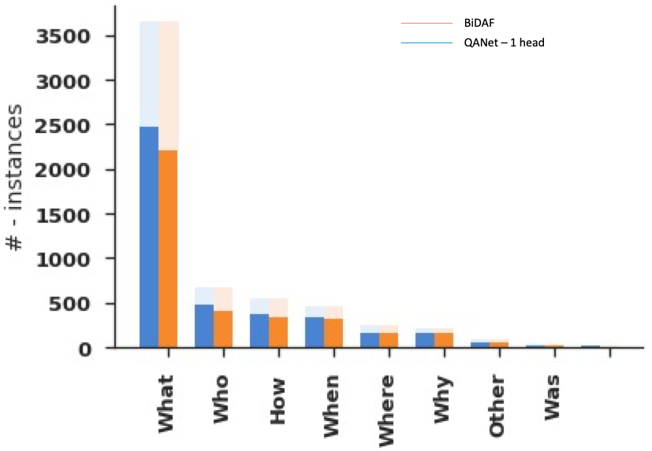
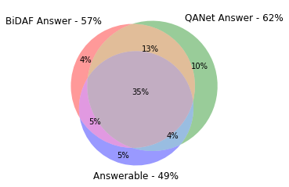
Analysis
Notes:
The main feature SQuAD [2.0] dataset is unanswerable questions. Comparing the QANet results against the BiDAF (refer Figure 4), we find that QANet attempts to answer 62% questions from the development set and predicts the answerability wrong 28% of the time (6% worse than BiDAF). Of these incorrect answerability predictions, the model is biased towards answering a question (23%) rather than refraining (5%).
The breakdown of correct answers (F1 > 0.5) by question categories is shown in the bar chart on the right. Unsurprisingly the largest headroom lies in the What-type questions.

Slide 10
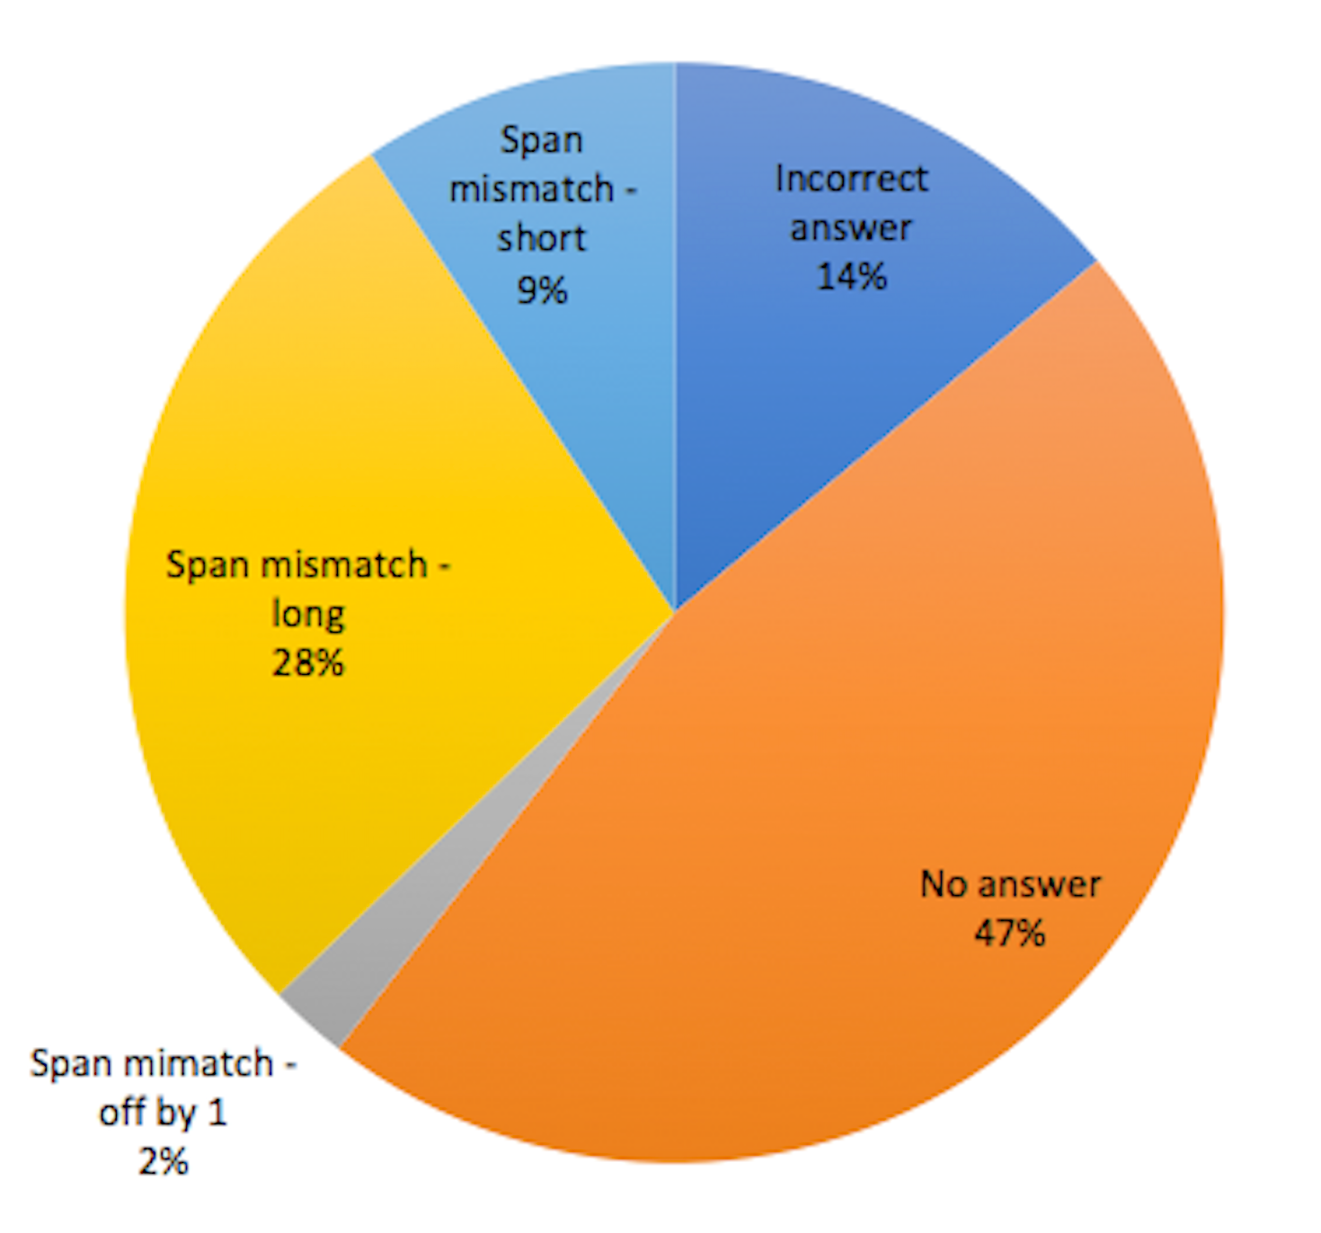
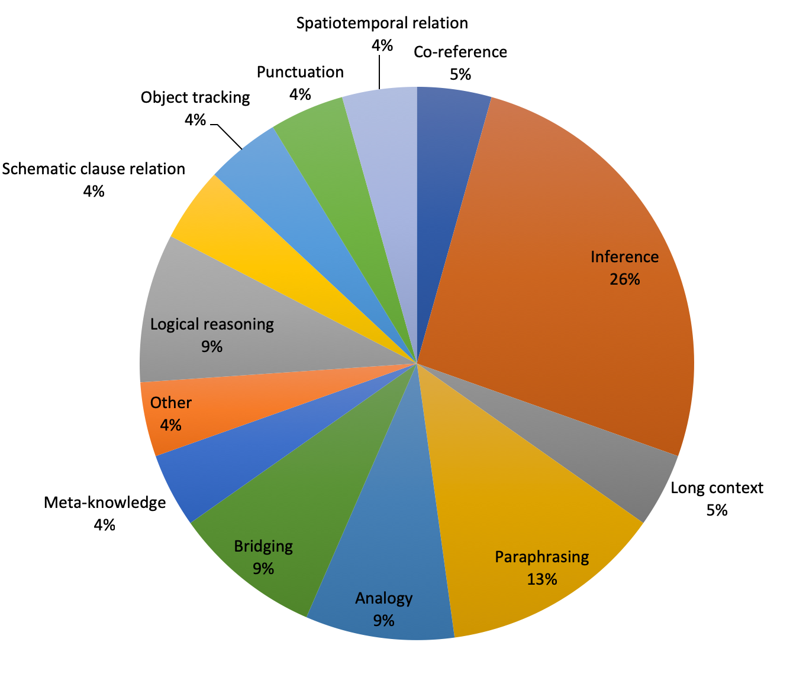
Analysis
Saku Sugawara, Yusuke Kido, Hikaru Yokono, and Akiko Aizawa. Evaluation metrics for machine reading comprehension: Prerequisite skills and readability. In Proceedings of the 55th Annual Meeting of the Association for Computational Linguistics (Volume 1: Long Papers), volume 1, pages 806–817, 2017.
Notes:
We randomly sampled 50 question of both answerable and unanswerable types separately and performed error analysis. Unfortunately due to time constraints, the error analysis was done on our initial set of results and not our best model (which was run with 4 attention heads). But we spot checked results from the best model and noted any changes. We identified a set of error categories. Also, we tried to identify the underlying root cause / different comprehension skills (co-reference etc.) needed by the the system as described in [15]. Breakdown of errors by category and skills are shown in Figure 6. Examples for each error type and comprehension skill is shown in the Table 1.
We find that for the error cases where there is partial match on span, training a larger model (increased number of attention heads, bigger hidden_size etc.) reduces the error. In fact this is the largest error category (48%).
Only when there is no answer predicted by the model or when the answer is completely incorrect, we categorize the error by the deficiency in comprehension skill. In addition to the skills defined in the paper referred above we added two categories: Long context and Paraphrasing as these did not fit into skillset defined by the paper.

Slide 11
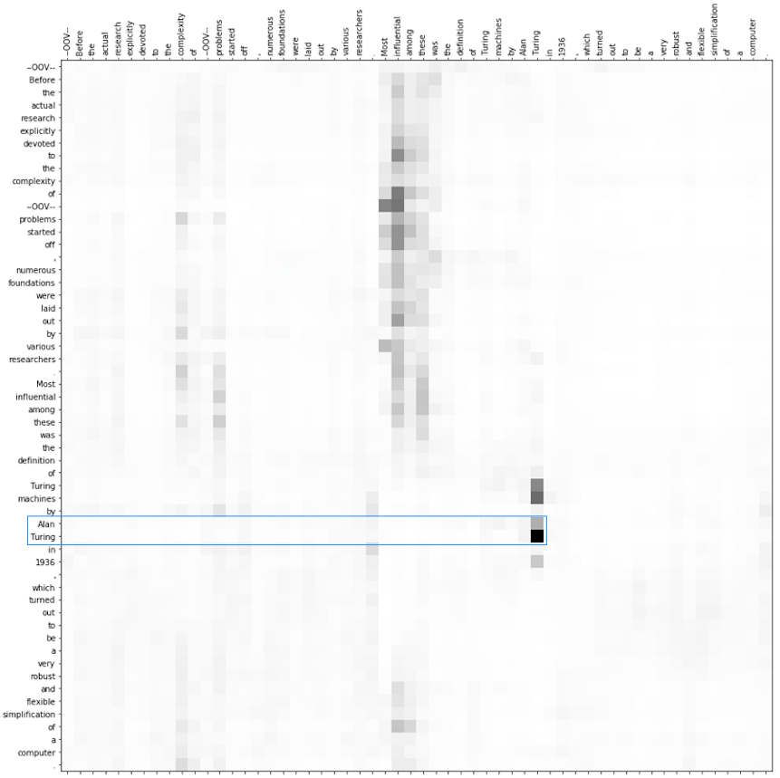
Analysis
Notes:
It was delightful to see “Attention at Work”
We visualized the attention distribution in the last encoder block of the first stacked encoder block in the model encode layer (encoder block 7 of 21). Given the question Who was the most influential researcher among those grappling with the deficit of work surrounding the complexity posed by algorithmic problems?, the tokens corresponding to the correct answer, {Alan, Turing} from the context get the highest levels of attention

Slide 12
Conclusion
In this work, we implemented the QANet model for machine reading comprehension
Evaluated the model against the SQuAD [2.0] dataset and analyzed the results
Future work:
Answerability prediction improvements
General accuracy improvements for answerable questions
Porting ideas from Transfomer-XL etc.
Notes:
In this work, we implemented the QANet model for machine reading comprehension. We evaluated the model against the SQuAD [2.0] dataset and analyzed the results. Prior to the recent PCE methods, QANet was the SoTA system for question answering. QANet is a complex model with more than 130 layers. Implementing the architecture correctly in a short span time based on the brief descriptions in the paper was a huge challenge.
As stated earlier, our motivation behind choosing this project was to carefully study the key ideas (such as, attention mechanism, pointer networks etc.) from the recent innovations of neural architectures that the QANet is built upon. We hoped to gain hands-on experience by implementing the architecture “from the scratch”. We believe we have accomplished this learning goal.
However, due to time constraints, we could not further explore adapting QANet architecture for SQuAD [2.0] dataset. At the outset, we want to pursue ideas along two different dimensions:
Answerability prediction improvements: Previous works, including the framework supplied as part of the baseline implementation for default final project, usually predict an additional “no-answer” probability to detect unanswerable cases. Given a context of N tokens, this model predicts start/end probabilities for N + 1 positions. The start/end probabilities in the extra position are used for answerability prediction. Other approaches include adding auxiliary losses to the system or encoding the no-answer option within the model.
General accuracy improvements for answerable questions: Borrowing some ideas from Transformer- XL architecture [5] to improve accuracy of QANet, especially for handling long-range dependencies could prove valuable.
Further, evaluating against domain-specific datasets such as CliCR [16] would be another future direction.

Slide 13
References
[1] Christopher JC Burges. Towards the machine comprehension of text: An essay. TechReport: MSR-TR- 2013-125, 2013.
[2] Danqi Chen, Adam Fisch, Jason Weston, and Antoine Bordes. Reading wikipedia to answer open-domain questions. arXiv preprint arXiv:1704.00051, 2017.
[3] François Chollet. Xception: Deep learning with depthwise separable convolutions. In Proceedings of the IEEE conference on computer vision and pattern recognition, pages 1251–1258, 2017.
[4] Christopher Clark and Matt Gardner. Simple and effective multi-paragraph reading comprehension. arXiv preprint arXiv:1710.10723, 2017.
[5] ZihangDai*,ZhilinYang*,YimingYang,WilliamW.Cohen,JaimeCarbonell,QuocV.Le,andRuslan Salakhutdinov. Transformer-XL: Language modeling with longer-term dependency, 2019.
[6] Jacob Devlin, Ming-Wei Chang, Kenton Lee, and Kristina Toutanova. Bert: Pre-training of deep bidirectional transformers for language understanding. arXiv preprint arXiv:1810.04805, 2018.
[7] Minghao Hu, Yuxing Peng, Zhen Huang, Nan Yang, Ming Zhou, et al. Read+ verify: Machine reading comprehension with unanswerable questions. arXiv preprint arXiv:1808.05759, 2018.
[8] Yoon Kim. Convolutional neural networks for sentence classification. arXiv preprint arXiv:1408.5882, 2014.
[9] Jeffrey Pennington, Richard Socher, and Christopher Manning. Glove: Global vectors for word representation. In Proceedings of the 2014 conference on empirical methods in natural language processing (EMNLP), pages 1532–1543, 2014.
[10] MatthewEPeters,MarkNeumann,MohitIyyer,MattGardner,ChristopherClark,KentonLee,andLuke Zettlemoyer. Deep contextualized word representations. arXiv preprint arXiv:1802.05365, 2018.
[11] Pranav Rajpurkar, Robin Jia, and Percy Liang. Know what you don’t know: Unanswerable questions for squad. arXiv preprint arXiv:1806.03822, 2018.
[12] Pranav Rajpurkar, Jian Zhang, Konstantin Lopyrev, and Percy Liang. Squad: 100,000+ questions for machine comprehension of text. arXiv preprint arXiv:1606.05250, 2016.
[13] Minjoon Seo, Aniruddha Kembhavi, Ali Farhadi, and Hannaneh Hajishirzi. Bidirectional attention flow for machine comprehension. arXiv preprint arXiv:1611.01603, 2016.
[14] Rupesh Kumar Srivastava, Klaus Greff, and Jürgen Schmidhuber. Highway networks. arXiv preprint arXiv:1505.00387, 2015.
[15] Saku Sugawara, Yusuke Kido, Hikaru Yokono, and Akiko Aizawa. Evaluation metrics for machine reading comprehension: Prerequisite skills and readability. In Proceedings of the 55th Annual Meeting of the Association for Computational Linguistics (Volume 1: Long Papers), volume 1, pages 806–817, 2017.
[16] Simon Šuster and Walter Daelemans. Clicr: a dataset of clinical case reports for machine reading comprehension. arXiv preprint arXiv:1803.09720, 2018.
[17] Ashish Vaswani, Noam Shazeer, Niki Parmar, Jakob Uszkoreit, Llion Jones, Aidan N Gomez, Łukasz Kaiser, and Illia Polosukhin. Attention is all you need. In Advances in Neural Information Processing Systems, pages 5998–6008, 2017.
[18] Shuohang Wang and Jing Jiang. Machine comprehension using match-lstm and answer pointer. arXiv preprint arXiv:1608.07905, 2016.
[19] Wenhui Wang, Nan Yang, Furu Wei, Baobao Chang, and Ming Zhou. Gated self-matching networks for reading comprehension and question answering. In Proceedings of the 55th Annual Meeting of the Association for Computational Linguistics (Volume 1: Long Papers), volume 1, pages 189–198, 2017.
[20] Dirk Weissenborn, Georg Wiese, and Laura Seiffe. Making neural qa as simple as possible but not simpler. arXiv preprint arXiv:1703.04816, 2017.
[21] AdamsWeiYu,DavidDohan,Minh-ThangLuong,RuiZhao,KaiChen,MohammadNorouzi,andQuocV Le. Qanet: Combining local convolution with global self-attention for reading comprehension. arXiv preprint arXiv:1804.09541, 2018.

Slide 14
Thank You

